Slide 1
System Resource Monitoring
and Visualization
Team Members:
Füsun Funda AKAY
201511001
İbrahim Arda ACAR
201611003
Mustafa AYDEMİR
201211007
Advisor:
Asst. Prof. Sibel Tarıyan Özyer

Slide 2
Contents
● Problem
● Solution
● What is System Resource Monitoring and Visualization(SRMV)?
● Technologies
● Work Structure
● User Interface Design
● Audience
● Conclusion
● Work Plan
● References

Slide 3
Problem
As technology developed, physical computers turned into virtual machines.
Afterwards, these virtual machines were moved to servers and their numbers increased.
But as the number of virtual machines increased, it became harder to control them.
It has become difficult to control who is logged into the virtual machines and the number of these people, the competence of the virtual machine at that time, how long the machine has been on, and its communication with other machines.

Slide 4
Solution
As a solution to this problem, we aimed to design a website and connect to the virtual machine through the website, to capture the current system data of the virtual machine and to show it with charts and graphics on the website.

Slide 5
What is SRMV?
SRMV is a web-based server monitoring tool that lets you and your team monitor important metrics of your remote servers.
Features:
CPU Usage
Memory (RAM) Usage
User List
IP Address List of the Users
Uptime

Slide 6







Technologies

Slide 7
Work Structure
Virtual servers can be created from the panel
The data to be monitored is updated every minute by connecting to the virtual servers.
Users can add teammates to the dashboard.

Slide 8
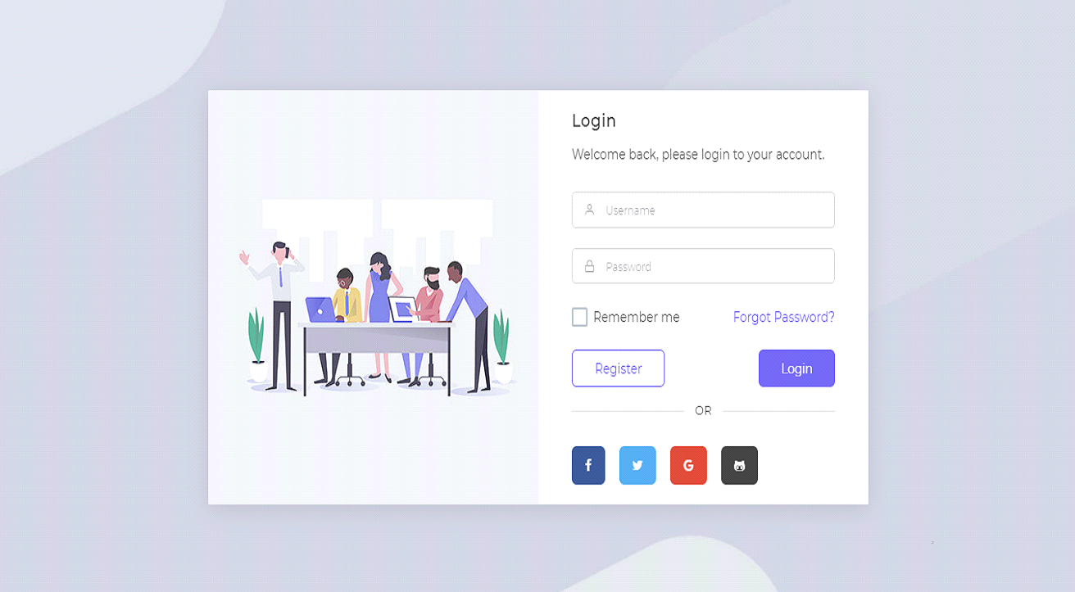
User Interface Design
Login Page

Slide 9
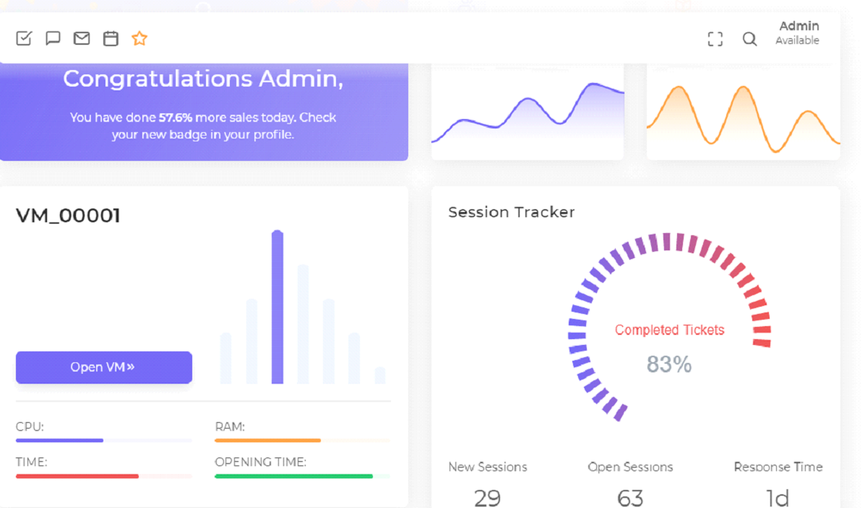
User Interface Design
Dashboard Page

Slide 10
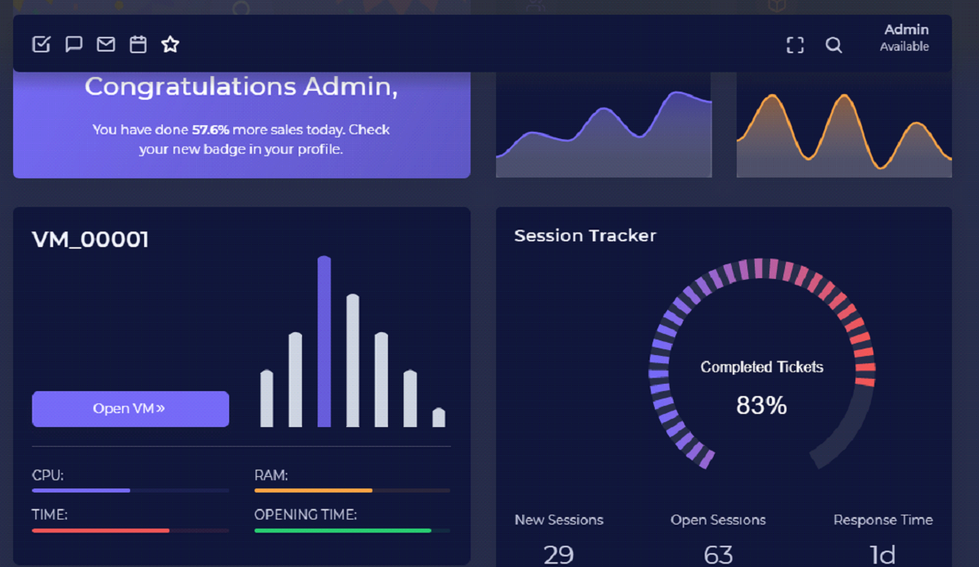
User Interface Design
Dashboard Page

Slide 11

User Interface Design
Register Page

Slide 12

User Interface Design
Forgot Password Page

Slide 13

User Interface Design
Reset Password Page

Slide 14
Audience
System Administrators
Software Developers

Slide 15
Conclusion
The following were specifically explored when creating this project.
Bootstrap framework.
Virtual machine technology.
Data visualization.
Virtual Machine Introspection.
830-1998 - IEEE Recommended Practice for Software Requirements
1016-1987 - IEEE Recommended Practice for Software Design Descriptions

Slide 16
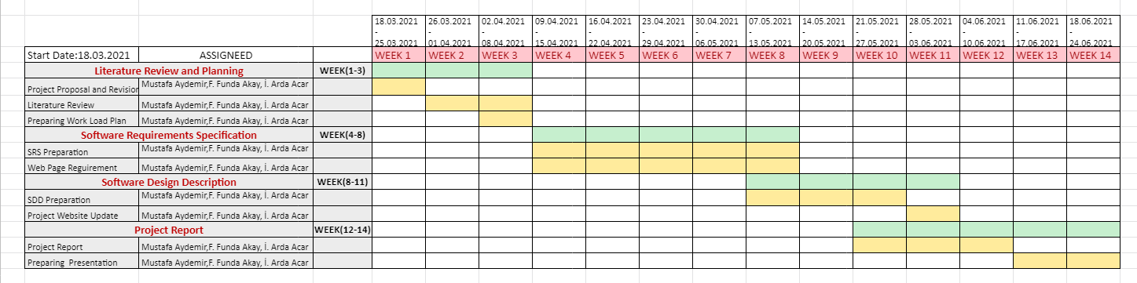
Work Plan

Slide 17
References
R. Zolfaghari, A. Sahafi, A.M. Rahmani, R. Rezaei, Application of Virtual Machine Consolidation in Cloud Computing Systems, Sustainable Computing: Informatics and Systems, Volume 30, June 2021, 100524, DOI: 10.1016/j.suscom.2021.100524, https://www.sciencedirect.com/science/article/abs/pii/S2210537921000172
User Guide, Introduction to the Administration Panel, https://docs.cs-cart.com/latest/user_guide/admin_panel.html#:~:text=The%20Administration%20Panel%20(or%20the,store%20and%20do%20much%20more.
Temere, Befekadu, Responsive Web Application Using Bootstrap and Foundation, 01 June 2017, https://www.theseus.fi/bitstream/handle/10024/130524/Befekadu_Temere.pdf?sequence=1&isAllowed=y, https://www.theseus.fi/handle/10024/130524
46 Free Bootstrap Admin Dashboard Templates For Your Web App 2021, https://colorlib.com/wp/free-bootstrap-admin-dashboard-templates/
James E. Smith, Ravi Nair, Description in: Virtual Machines Versatile Platforms for Systems and Processes A volume in The Morgan Kaufmann Series in Computer Architecture and Design, 2005, DOI: 10.1016/B978-1-55860-910-5.X5000-9, https://www.sciencedirect.com/book/9781558609105/virtual-machines#book-description
W. Chen, F. Guo, Fei-Yue Wang , A Survey of Traffic Data Visualization, IEEExplore, Volume: 16, Issue: 6, Dec. 2015, DOI: 10.1109/TITS.2015.2436897 , https://ieeexplore.ieee.org/abstract/document/7120975?casa_token=xc0vZNy_AVYAAAAA:u9yR02_FmWz7VoWWnnWNn1G9RELNu5JV-yMf5t6QQq8kh4-M1BBbMdiAKQuPWTfY68-gysjAOQ
S. Çelik, E. Akdamar, Büyük Veri ve Veri Görselleştirme, Akademik Bakış Uluslararası Hakemli Sosyal Bilimler Dergisi, Volume , Issue 65, Pages 253 – 264, Year 2018, https://dergipark.org.tr/en/pub/abuhsbd/issue/36059/404871
R. Vallat, E. Combrisson, J.-B. Eichenlaub, C. O'Reilly, T. Lajnef A. Guillot, P. Ruby, K. Jerbi , Sleep: A Python Open-Source Software For Visualizing and Scoring Sleep Data, Sleep Medicine, Volume 40, Supplement 1, December 2017, Page e333, DOI: 10.1016/j.sleep.2017.11.979, https://www.sciencedirect.com/science/article/abs/pii/S1389945717314120
Vuexy VueJS & Vue + Laravel Admin, 2021, https://pixinvent.com/demo/vuexy-vuejs-admin-dashboard-template/landing/

